Slide 1




Shreyas Goyal
ZOMATO
Analytics
Dashboard
19-07-2024

Slide 2
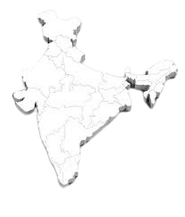


GOALS AND OBJECTIVES
01
The Global restaurant industry is USD 2.3 billion giant which is expected to grow to USD 2.4 billion by 2030
02
Zomato, a leading online food ordering and restaurant platform. To identify the most promising regions for future growth
03
This project delves into a rich dataset of Zomato restaurants across the globe.
By analyzing factors like cuisine preferences, average cost, and online ordering trends, we aim to uncover hidden gems – locations for Zomato's expansion
04
Through meticulous data exploration, we'll create a roadmap, guiding Zomato towards regions with the most potential for a flourishing restaurant scene.

Slide 3

Understanding our Restaurants Landscape
01
02
03
04
Attributes
Data Importance
Key Data Points
Data cleaning and preprocessing
Total Records: 9551
Attributes: 20 (RestaurantID, RestaurantName, CountryCode, City, Address, Locality, LocalityVerbose, Longitude, Latitude, Cuisines, Currency, Has_Table_booking, Has_Online_delivery, Is_delivering_now, Switch_to_order_menu, Price_range, Votes, Average_Cost_for_two, Rating, Datekey_Opening)
Country Description: 2 (CountryCode, Country Name)
This data is critical for analyzing trends in the restaurant industry across different countries.
Examining factors like average rating, number of restaurants, price range, and online delivery options.
We can identify potential locations for opening new restaurants that are likely to be successful.
Countries: Data includes restaurants from various countries.
Ratings: Average rating can help identify customer satisfaction levels.
Price Range: Distribution of restaurants across price ranges helps understand market competition.
Online Delivery & Booking: Shows if these services impact customer ratings.
Votes: Indicates customer review volume and market demand.
Data Cleaning:
Removed duplicates (0 found)
Addressed missing values:
Replaced blank average cost for two with average cost in that price range
Replaced blank/invalid Lat/Long with values from non-duplicate Locality Verbose entries using VLOOKUP
Fixed date format inconsistencies in Datekey_Opening column
Preprocessing:
Created a new "Price Category" column combining currency symbol and average cost

Slide 4





Analytical approach
Data cleaning
Duplicate removal (none in this data)
Missing/ Zero values Handling
Removing inconsistency
Data preprocessing
New field - Price concatenating with currency symbol.
Country field using VLOOKUP
Extracting year
Descriptive Statistics
Pivot tables Average Rating, average votes
Restaurants per country
Average cost for two
Used bar, column charts for restaurants distribution across countries
Segmented data by sort / filter pivoted data to across cuisines, countries, cities & price ranges.
Slicers for dynamic filtering
Visualization and Data segmentation

Slide 5
Country and city wise analysis
Country Restaurant counts Market percentage
India | 8652 | 90.59%
United States of America | 434 | 4.54%
United Kingdom | 80 | 0.84%
Brazil | 60 | 0.63%
South Africa | 60 | 0.63%
United Arab Emirates | 60 | 0.63%
New Zealand | 40 | 0.42%
Turkey | 34 | 0.36%
Australia | 24 | 0.25%
Philippines | 22 | 0.23%
Indonesia | 21 | 0.22%
Sri Lanka | 20 | 0.21%
Singapore | 20 | 0.21%
Qatar | 20 | 0.21%
Canada | 4 | 0.04%
Filtering countries and cities with more competition and Market Saturation
India has more competition with 90% market occupancy
New Delhi, Gurgaon, Noida , Faridabad have 69% global market occupancy
We won’t suggest these places as there is already market saturation
We suggest to open restaurants in countries or cities with minimal competition
City Restaurant counts Market percentage
New Delhi | 5473 | 57.30%
Gurgaon | 1118 | 11.71%
Noida | 1080 | 11.31%
Faridabad | 251 | 2.63%
Ghaziabad | 25 | 0.26%
Bhubaneshwar | 21 | 0.22%
Lucknow | 21 | 0.22%
Ahmedabad | 21 | 0.22%

Slide 6
Analysis as per the average price
Number of restaurants across different price range along with the average for two.
There are more number of restaurants in the price range 1
The average cost for two in the price range of 1 is 276.2 which is minimum of all
This shows that most of the restaurants in India target customer with affordable budget
Price range Count of Restaurant Average of votes Average of cost for two
1 | 4444 | 44.59743474 | 276.2975338
2 | 3113 | 147.6071314 | 596.8262127
3 | 1408 | 443.8607955 | 5177.268466
4 | 586 | 368.5955631 | 1848.523891

Slide 7
Analysis based on popularity of votes
Average vote across countries and yearly trends of restaurant
Average number of votes tell about the popularity of restaurant in different countries
Indonesia, UAE, Turkey, Phillipines, USA, and South Africa are countries with most customer popularity
Recent trends in number of restaurant opened shows double growth since 2016

Slide 8
Extra services and ratings relation
Rating insights from restaurant having table bookings and online delivery
12% of the total restaurants across globe have an option for table booking
25 % of total restaurants across globe have option for online delivery
We see that average ratings is better when restaurant has table booking and online delivery services.
So we can introduce these services in the newly opened restaurants in suggested countries

Slide 9
Top most cuisines by number of restaurants
Top 30 cuisines by number of restaurants
The insights shows popular cuisines across the globe.
North India part has 69% market saturation which is clearly justified by most popular cuisine as north Indian
These insights work well and show more depth if we have slicers

Slide 10
To 20 suggested cites
Top 20 suggested cities by average rating
Filtering out the cities with more than %5 of market occupancy to get less competition.
Best 5 city are Inner City, Quezon City, Makati City, Pasig City and Mandaluyong City

Slide 11

Strategic Recommendation
Strategic Recommendation
Target High demand , High Satisfaction Market. Prioritize opening new restaurants in countries with:
High Average Rating
Low Restaurant Density
Expected Impact
Data shows customers in the suggested countries are generally more satisfied with restaurants, indicating a potential market gap for your specific cuisine or concept.
Look for countries with a lower number of restaurants compared to others. This suggests less competition and potentially higher market share opportunities.
This targeted approach increases the likelihood of finding a receptive customer base, leading to higher customer satisfaction and brand loyalty.

Slide 12
Strategic Recommendation
Strategic recommendation
Leverage Technology for Convenience and Customer Engagement
Recommendation
Expected Impact
Implement online delivery and table booking services in all new restaurants. Data suggests restaurants offering these services might have higher average ratings
Providing convenient online ordering and booking options can attract customers who value these features and potentially improve overall customer experience.

Slide 13
Strategic Recommendation
Strategic Recommendation
Consider Price Optimization based on Market Demand
Recommendation
High-Rating, Budget-Friendly Markets
Expected Impact
Analyze the average cost for two in different countries alongside average rating. Look for opportunities to adjust pricing strategy for new restaurants.
Offer competitive pricing to capture a wider customer base.
A data-driven pricing strategy can attract customers while maintaining profitability in the chosen market.
High-Rating, Premium-Priced Markets
Consider a premium menu with high-quality ingredients to cater to existing preferences.

Slide 14
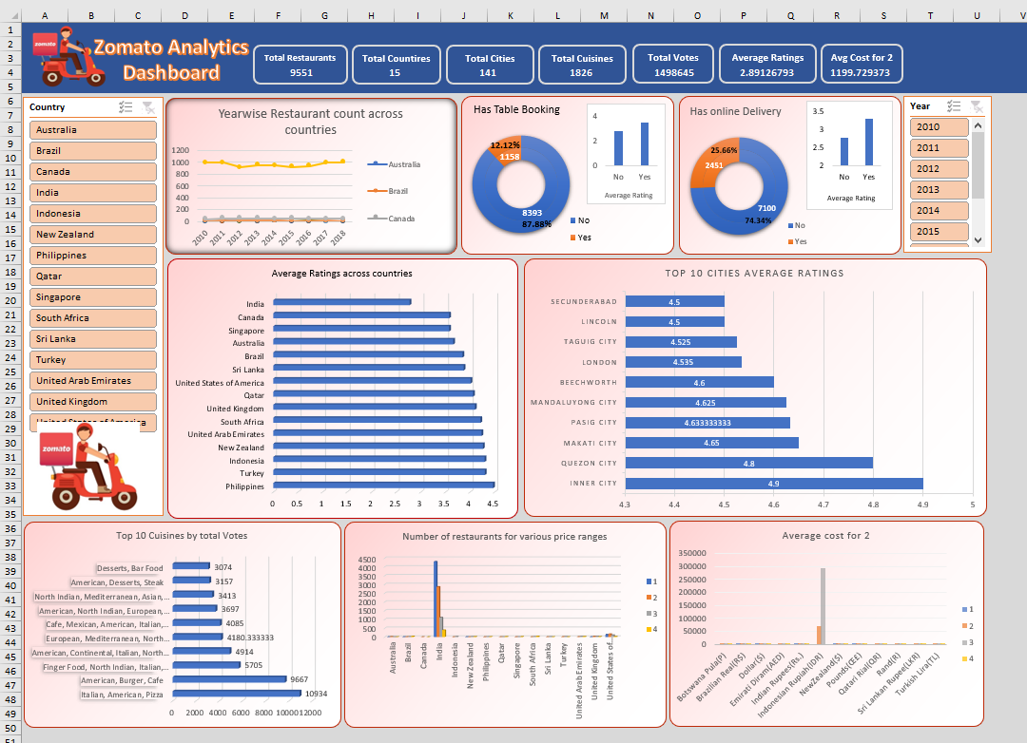

Slide 15
Conclusion
By analyzing restaurant data, we've identified promising opportunities for global expansion.
Countries with high average ratings and lower restaurant density present fertile ground for establishing new ventures.
Specifically, our data suggests targeting cities in Indonesia and Philippines for their strong customer satisfaction and potential for less competition.
This data-driven approach allows us to prioritize locations with a higher chance of success, paving the way for strategic restaurant placement and a flourishing global presence.
In conclusion, our analysis of the restaurant data empowers us to make strategic decisions for growth:
Target High – Potential Markets
Excellence
Optimize Pricing Strategy
Data Driven Growth
Embrace Technology
Prioritize countries with high average customer ratings and lower restaurant density to find receptive markets for new restaurants.
Implement online delivery and table booking services to enhance customer convenience and potentially boost satisfaction.
Analyze the relationship between average cost and customer ratings to inform pricing decisions for new restaurants, considering budget-friendly or premium approaches based on market demand.
By leveraging these data-driven insights, we can increase our market share, improve customer satisfaction, and achieve successful restaurant expansion.

